Slide 1
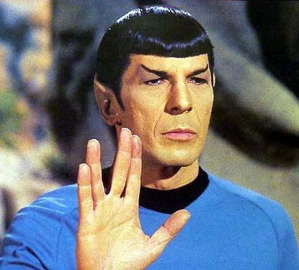
Boolean Logic

Slide 2
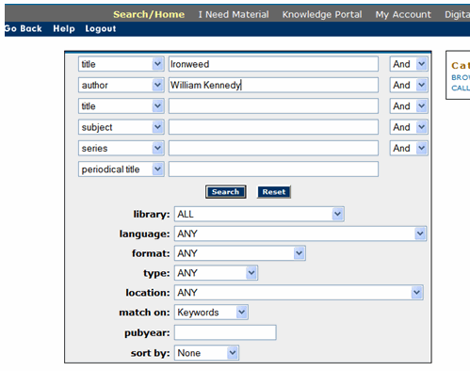
What is Truth
Notes:
Programming is not philosophy. It deals in absolutes. It can determine if a statement is true or false and will always get the same answer given the same conditions.
Even random numbers work this way (seeds)

Slide 3
The Hard Questions
if(it's ok to steal a loaf of bread to feed your family){
//do it
} else {
//starve
}
Notes:
A computer cannot help us here

Slide 4
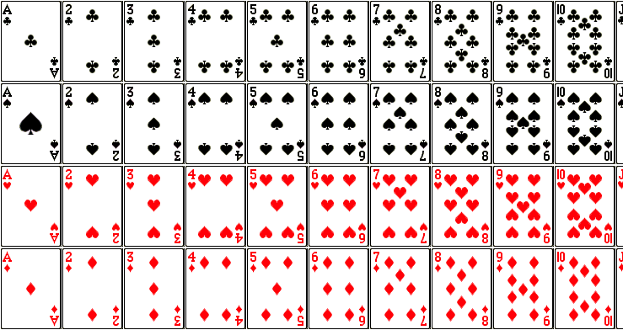
AND, OR, NOT
Notes:
- How many red cards?
- How many 2s?
- How many cards are red AND 2?
- How many cards are red OR 2?
- How many cards do NOT have an object in the center?
- How many of those are greater than 6?
- How many are even AND red AND hearts?

Slide 5
How many cards:
  Are an even number
  AND are hearts
  AND have one column
  OR have two columns

Slide 6
How many cards:
  Are an even number
    AND are hearts
    AND have one column
  OR have two columns
(“Even” AND “hearts” AND “one column”) OR (“two columns”)

Slide 7
Java Syntax
AND is &&
OR is ||
NOT is !

Slide 8
(“Even” AND “hearts” AND “one column”) OR (“two columns”)
(“Even” && “hearts” && “one column”) || (“two columns”)

Slide 9
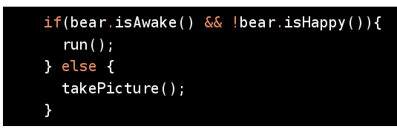
Java Syntax
AND is &&
OR is ||
NOT is !

Slide 10
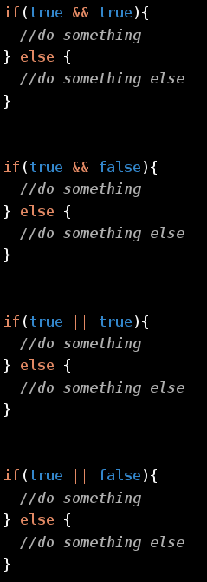

Slide 11
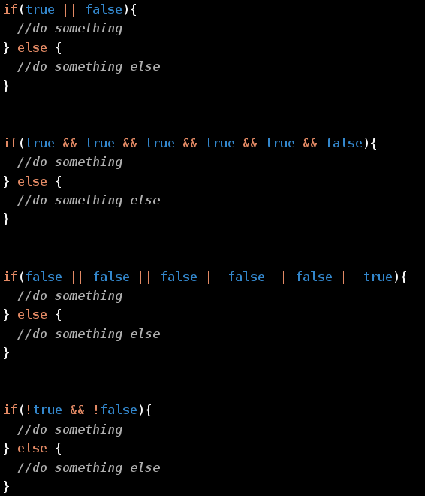

Slide 12
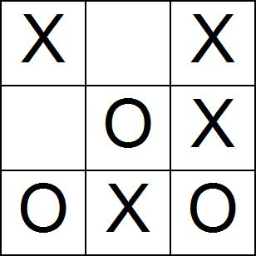
Tic Tac Toe
What are the rules?
How do you win?
Notes:
How many ways are there to win?
- Get the greenfoot tic tac toe source
- play in greenfoot
- what is wrong?
- How do we fix it?

